Slide 1
Propensity Modeling
for an E-Commerce Company
Concept Guide

Slide 2
Contents:
Business Problem
Data Summary
Propensity Modeling - Concept
Propensity Modeling - Real world examples
Propensity Modeling - Trigger based model

Slide 3
Business Problem
Our Client is an early stage e-commerce company selling various products from daily essentials (such as Dairy & vegetables) to high end electronics and home appliances.
It is a one year old company and they are witnessing many people coming to their platform and searching products but only few end up purchasing.
To increase the number of purchases, the business is planning to send discounts or coupons to users to motivate them to buy.
But since it an early stage startup, they have only limited funds for this discount campaign. So, they have reached out to us seeking our help in building a model that would predict the purchase probability of each users in buying a product.
With this probability scores, the marketing team can then filter only those users who need the actual push (in terms of discounts or coupons) to make a purchase rather than sending coupons to users who would have bought the product anyways.

Slide 4
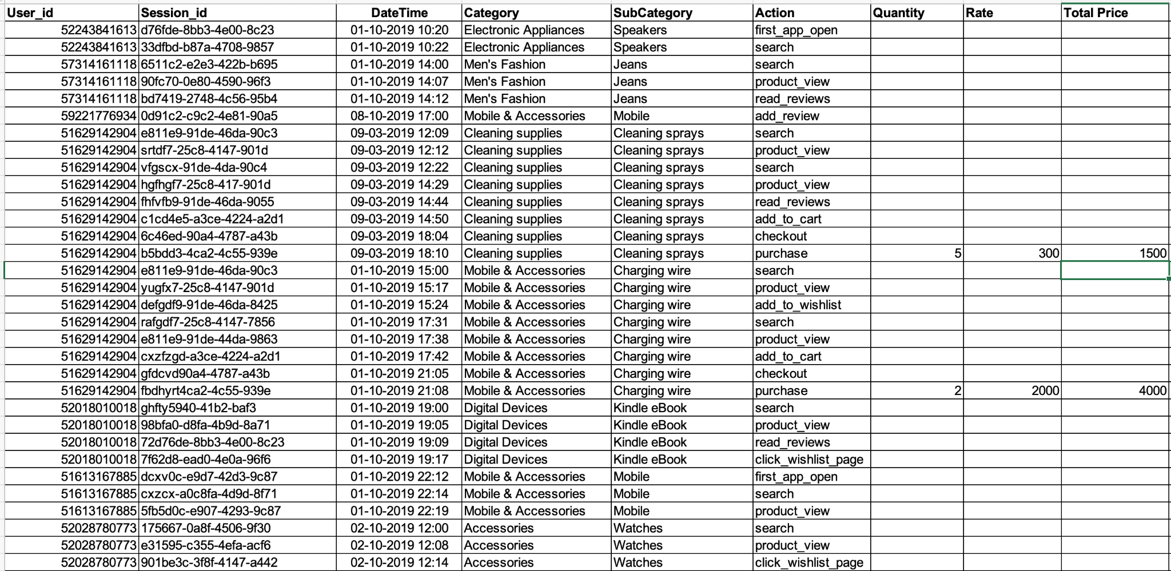
Data Summary
Columns | Description
User_id | Unique identifier for each user
Session_id | Unique identifier generated every time an user comes to the platform
DateTime | Timestamp when an action is performed
Category | Product Category
SubCategory | Product Sub Category
Action | Actions that an user could do in the app such as product view, read reviews, purchase,add to cart etc.
Quantity | Number of products ordered
Rate | Price of a single product
Total Price | Total order price (Quantity X Rate)

Slide 5
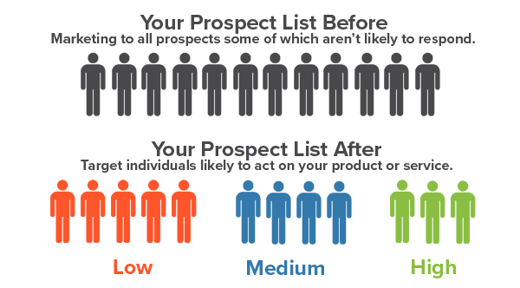
Propensity Modeling - Concept
Propensity modeling is a set of approaches to building predictive models to forecast behavior of a target audience by analyzing their past behaviors. That is to say, propensity models help identify the likelihood of someone performing a certain action.
We can then use this likelihood or probability score to create personalized targeting campaigns to the users thus reducing our total cost (targeting only small set of users) and increasing our ROI.

Slide 6
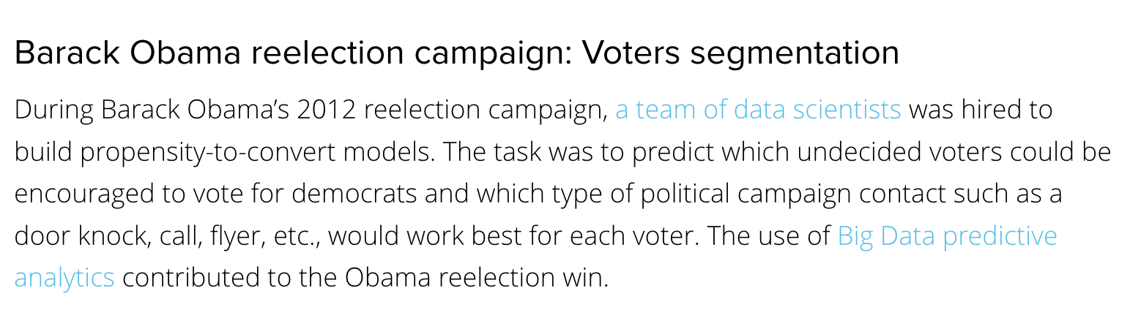
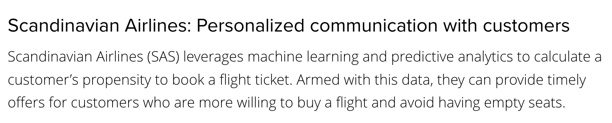
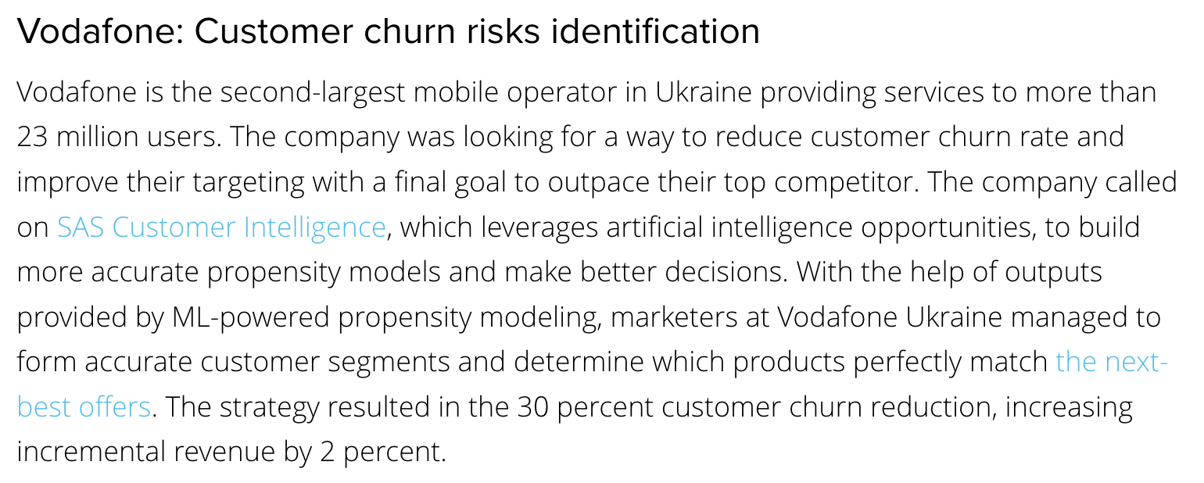
Propensity Modeling - Real world examples

Slide 7

Propensity Modeling - Trigger based Model
All users who are using the platform
Users who does the intended action
(add_to_cart, add_to_wishlist, etc.)
Users who made a purchase (Target - 1)
Training:
Taking all the user who does the intended action as our base population. In the next ‘t’ hour, if those users make a purchase then Target for those users will be 1 else 0. Using this target and the behavioural features of the users we create an ML model.
Inference:
Whenever a user does an intended action (such as add_to_cart, add_to_wishlist, etc.) the ML model gets triggered and it scores each user on their propensity to buy a product in the next ‘t’ hours.
Users who did not made a purchase (Target - 0)

